Slide 1
COVID 19 Physics year 10 lesson 7
Magnetic fields

Slide 2
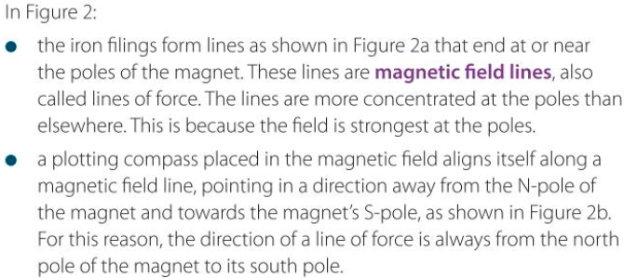

Slide 3
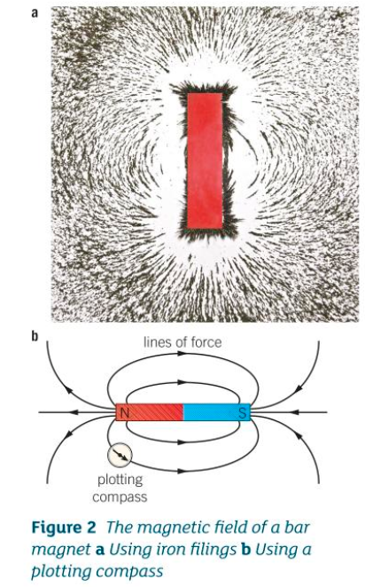
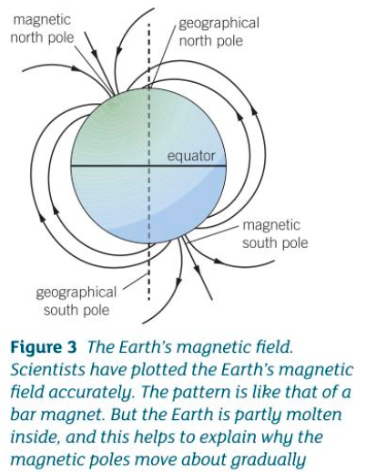

Slide 4
