Slide 1
COVID 19 Physics year 10 lesson 8
Magnetic fields and current

Slide 2
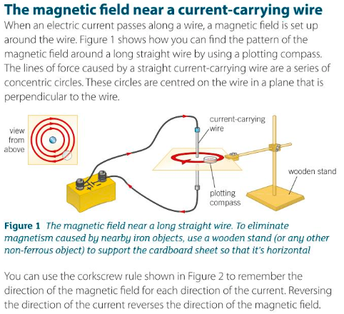
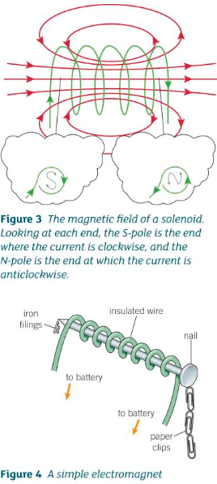

Slide 3
