Slide 1
COVID 19 Physics year 10 lesson 9
Motor effects

Slide 2
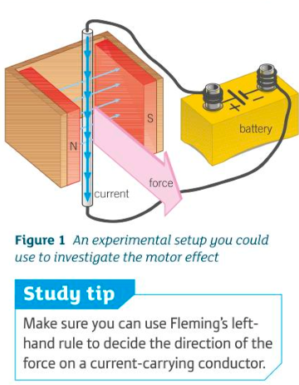

Slide 3
