Slide 1
Bridging Biology – Week 4
Final Task
Complete the Test (on the next few slides). Then mark it and complete green pen corrections (Send Mr Hammond Evidence of doing this such as picture of the test marked) and also your score.
The second task is to do Revision mind map on the Areas you made mistakes in (Remember a revision mind map should be detailed, not just key words! Diagrams should be incorporated where relevant and colour should be included. Remember there is a reason humans use colour vision, so use this ability also in your revision!)

Slide 2
A Level Biology Transition Baseline Assessment
The following 40 minute test is designed to test your recall, analysis and evaluative skills and knowledge.
Remember to use your exam technique: look at the command words and the number of marks each question is worth.
A suggested mark scheme is provided for you to check your answers.
a) What are the four base pairs found in DNA?
……………………………………………………………………………………………………………………………………………………………………….
(2)
b) What does DNA code for?
……………………………………………………………………………………………………………………………………………………………………….
(1)
c) Which organelle in a cell carries out this function?
……………………………………………………………………………………………………………………………………………………………………….
(1)
2. a) What theory did Charles Darwin propose?
……………………………………………………………………………………………………………………………………………………………………….
(1)
b) Why did many people not believe Darwin at the time?
……………………………………………………………………………………………………………………………………………………………………….
(1)
c) Describe how fossils are formed.
……………………………………………………………………………………………………………………………………………………………………….
……………………………………………………………………………………………………………………………………………………………………….
……………………………………………………………………………………………………………………………………………………………………….
(3)
d) The fossil record shows us that there have been some species that have formed and some that have
become extinct.
i) What is meant by the term ‘species’?
……………………………………………………………………………………………………………………………………………………………………….
(2)
ii) Describe how a new species may arise:
……………………………………………………………………………………………………………………………………………………………………….
……………………………………………………………………………………………………………………………………………………………………….
…………………………………………………………………………………………………………………………………………………………………(3)
© Copyright The PiXL Club Ltd, 2016

Slide 3
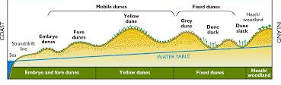
Ecologists regularly study habitats to measure the species present and the effect of any changes.
One team of ecologists investigated the habitat shown in the picture below:
Image taken from http://www.macaulay.ac.uk/soilquality/Dune%20Succession.pdf
a) Define the following keywords:
i) Population
…………………………………………………………………………………………………………………………………………………………………
ii) Community
…………………………………………………………………………………………………………………………………………………………………
(2)
b) Give an example of one biotic factor and one abiotic factor that would be present in this habitat
Biotic: ………………………………………………………………………………………………………………………………………………………
Abiotic: ………………………………………………………………………………………………………………………………………………………
(2)
c) Describe how the ecologists would go about measuring the species present between the coast and the
inland.
…………………………………………………………………………………………………………………………………………………………………
…………………………………………………………………………………………………………………………………………………………………
…………………………………………………………………………………………………………………………………………………………………
…………………………………………………………………………………………………………………………………………………………………
…………………………………………………………………………………………………………………………………………………………………
…………………………………………………………………………………………………………………………………………………………………
(6)
© Copyright The PiXL Club Ltd, 2016

Slide 4
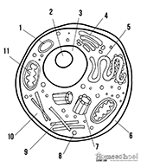
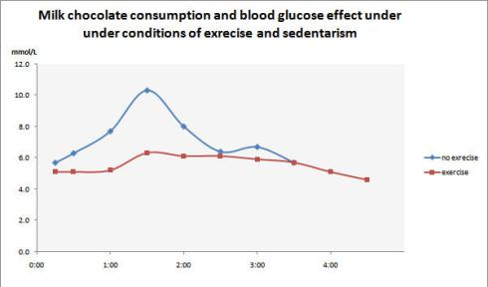
4. Every living organism is made of cells.
Image taken from http://prestigebux.com/worksheet/label-an-animal-cell-worksheet
a) Label the following parts of the animal cell:
2 ……………………………………………………………………………………………………………………………………………………………
5 ……..……………………………………………………………………………………………………………………………………………………
8 …………………………………………………………………………………………………………………………………………………………..
(3)
b) Describe how is the structure of the cell membrane related to its function?
…………………………………………………………………………………………………………………………………………………………………
…………………………………………………………………………………………………………………………………………………………………
…………………………………………………………………………………………………………………………………………………………………
(3)
5. A medical research team investigated how quickly the body deals with glucose after a meal. They studied the blood glucose concentration of people who exercised versus those who did not.
Here are their results:
Image taken from https://memoirsofanamnesic.wordpress.com/category/blood-glucose/
a) What organ in the body regulates blood glucose concentration?
…………………………………………………………………………………………………………………………………………………………………
(1)
Hours after eating
© Copyright The PiXL Club Ltd, 2016

Slide 5
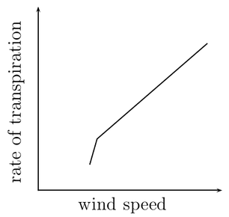
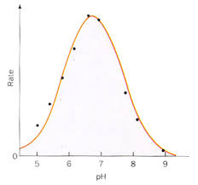
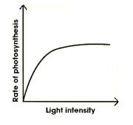
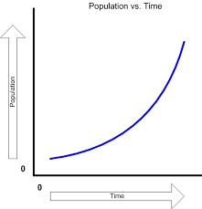
b) Explain how the stages that would bring about a return to normal blood glucose concentrations.
…………………………………………………………………………………………………………………………………………………………………
…………………………………………………………………………………………………………………………………………………………………
…………………………………………………………………………………………………………………………………………………………………
…………………………………………………………………………………………………………………………………………………………………
(4)
c) Name one variable the researchers will have controlled.
…………………………………………………………………………………………………………………………………………………………………
(1)
d) The researchers made the following conclusion:
“Blood glucose returns to normal values for all people after 4 hours”
To what extent do you agree with this conclusion.
…………………………………………………………………………………………………………………………………………………………………
…………………………………………………………………………………………………………………………………………………………………
…………………………………………………………………………………………………………………………………………………………………
…………………………………………………………………………………………………………………………………………………………………
(3)
Scientists need to be able to interpret data in graphs to decide if there are trends in the results.
For each graph bellow, describe the trend.
…………………………………………………………… ……………………………………………………………
…………………………………………………………… ……………………………………………………………(4)
Images taken from: http://www.everythingmaths.co.za/science/lifesciences/grade-10/05-support-and-transport-systems-in-plants/images/56aff2f9b6c5b041688f745ca928990c.png
http://www.bbc.co.uk/staticarchive/afa3f2b16b4d58d077943c96929c9a4020fea83a.gif
http://www.rpi.edu/dept/chem-eng/Biotech-Environ/Projects00/temph/enzyme.html
http://www.myearthwatchexperience.com/Essential%20Ecology.htm
© Copyright The PiXL Club Ltd, 2016

Slide 6
Suggested Mark Scheme:
Question |  |  | Answer | Marks
1 | a |  | Adenine-Thymine Cytosine-Guanine | 1 1
 | b |  | Protein/enzymes | 1
 | c |  | Ribosomes | 1
2 | a |  | Evolution (by natural selection) | 1
 | b |  | Not enough evidence | 1
 | c |  | (Plant/animal dies) and is quickly buried in sediment Not all conditions for decay are present Hard parts of the body are replaced by minerals | 1 1 1
 | d | i | Organisms that can reproduce to produce viable offspring/offspring that can also reproduce (fertile) | 1
 |  | ii | 3 from Geographical isolation/named example Mutation of genes Natural Selection/selective advantage Species can no longer interbreed (not produce fertile offspring) | 1 1 1 1
3 | a | i | A group of organisms, all of the same species, and all of whom live together in a particular habitat. | 1
 |  | ii | The total of all populations living together in a particular habitat. | 1
 | b |  | Biotic – one from: Predators, prey, plant, microbes Abiotic – one from: Availability of water, temperature, mineral concentration, reference to climate/weather | 1 1
 | c |  | Measure out a transect Using a tape measure Use a quadrat At regular (named) intervals Identify species present Using a key/guide | 1 1 1 1 1 1
4 | A |  | 2 Nucleolus 5 Smooth Endoplasmic Reticulum 8 Golgi body | 1 1 1
© Copyright The PiXL Club Ltd, 2016

Slide 7
Question |  |  | Answer | Marks
4 | b |  | Any 3 from the following structure and function must be given. Lipid bilayer - has a hydrophobic inside and hydrophilic outside, allowing for selective permeability Proteins - allow for specific substances to come or some molecules to pass through, Cholesterol - allows for fluidity of the membrane, Glycoproteins - for cell identification they serve as markers | 1 1 1 1
5 | a |  | Pancreas | 1
 | b |  | 3 from Pancreas detects change Insulin secreted By alpha cells Respiration increased Uptake of glucose increased Liver increases storage of glucose as glycogen | 1 1 1 1 1 1
 | c |  | Any one from: Amount of chocolate, time taken to eat, other food/drink consumed, age, gender, weight, fitness level/metabolic rate, health/pre existing conditions, use of medicines/drugs | 1
 | d |  | Any three from Data suggests that blood glucose returns to normal Doesn’t show how much exercise has been done Doesn’t say age/gender/other named variable May only be true for chocolate/only one type of food investigated | 1 1 1 1
6 |  |  | Top left: transpiration increases when wind speed increases/there is a positive correlation Top right: rate increases with pH until the optimum is reached, after the optimum, rate decreases Bottom left: Increasing light initially increases the rate of photosynthesis, but after a while remains constant Bottom right: Population increases slowly at first and then increases at a greater rate/increases exponentially | 1 1 1 1
© Copyright The PiXL Club Ltd, 2016

