Slide 1
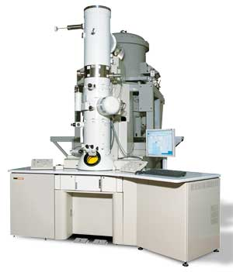
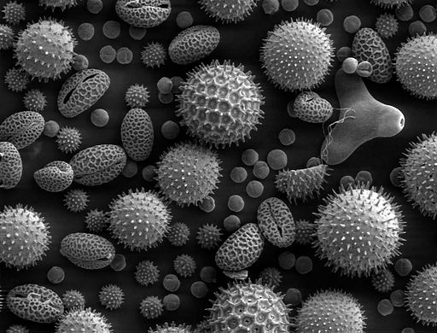
Electron Microscope

Slide 2
How do they work
Instead of using light they fire a beam of electrons (which have a wavelength less than 1nm compared to light which has a wavelength of 250nm across) which hugely increases the resolution.
They can also magnify images up to x500,000 (compared to light which has a maximum magnification of x1500)
The specimens have to be carefully prepared (e.g. embedded in resin or coated/stained with heavy metals) and are placed in a vacuum before a beam of electrons are fired

Slide 3
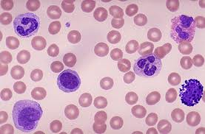
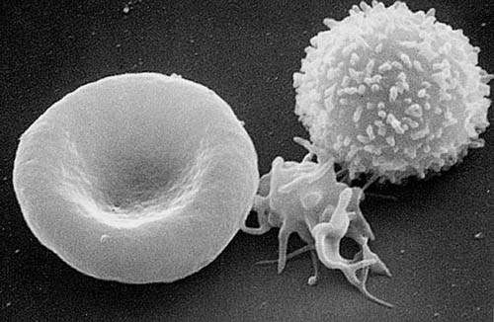
Light V Electron
White and red blood cells red blood cells (and platelet) and White blood cell

Slide 4
2 Types of Electron microscopes
Transmission electron microscope (TEM) – Sends electrons through a specimen and can create images with a resolution of 0.5nm but can only create 2D images.
Scanning electron microscope (SEM) – sends electrons across the surface of a specimen. Can create 3D images but has a slightly poorer resolution power (3 – 10nm)
With both types of images colour can be artificially added by a computer – when this happens they become false colour TEM/SEM micrographs

Slide 5
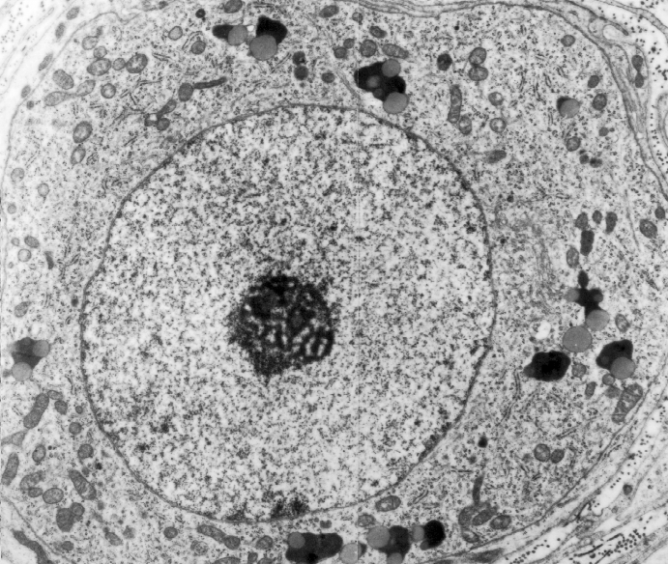
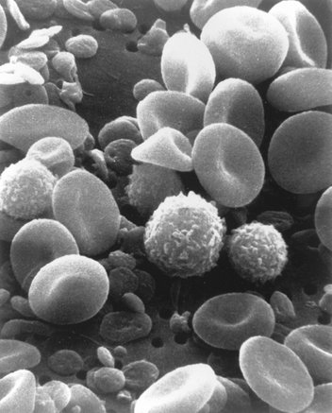
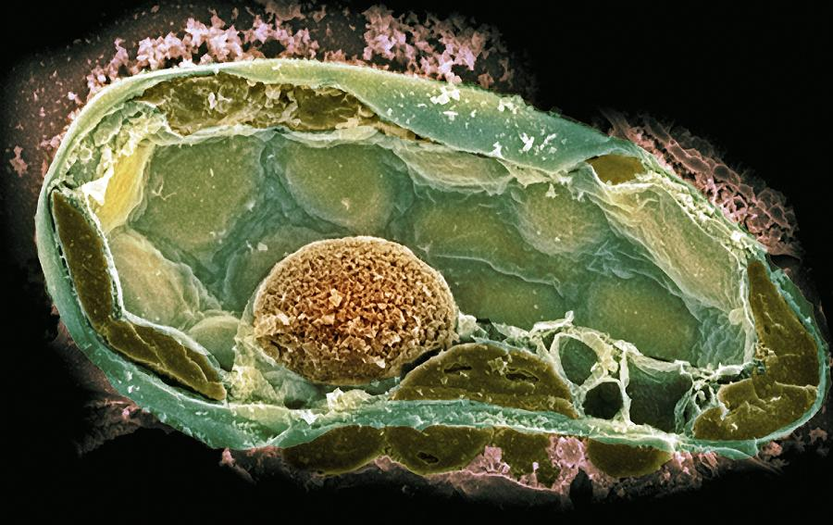
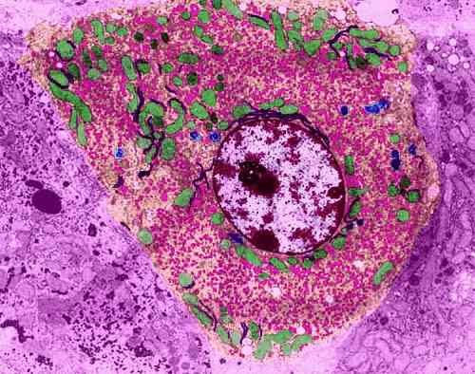
Which is which?

Slide 6
Laser scanning confocal microscopy
Light microscopy has also advanced.
Specimens need to be prepared using a fluorescent dye (obtained from a protein created by species of Jellyfish)
A focused beam of light (Laser) is then focused at the specimen and light is radiated from the specimen and is passed through a pinhole (collected) – this results in high resolution images and can also be used to create 3D images.
A big advantage is that it can be used to scan for certain type of molecules so they can be seen within a cell (the fluorescent markers can be specific to different parts of the cell). This is very useful to see how drugs interact with cells

Slide 7
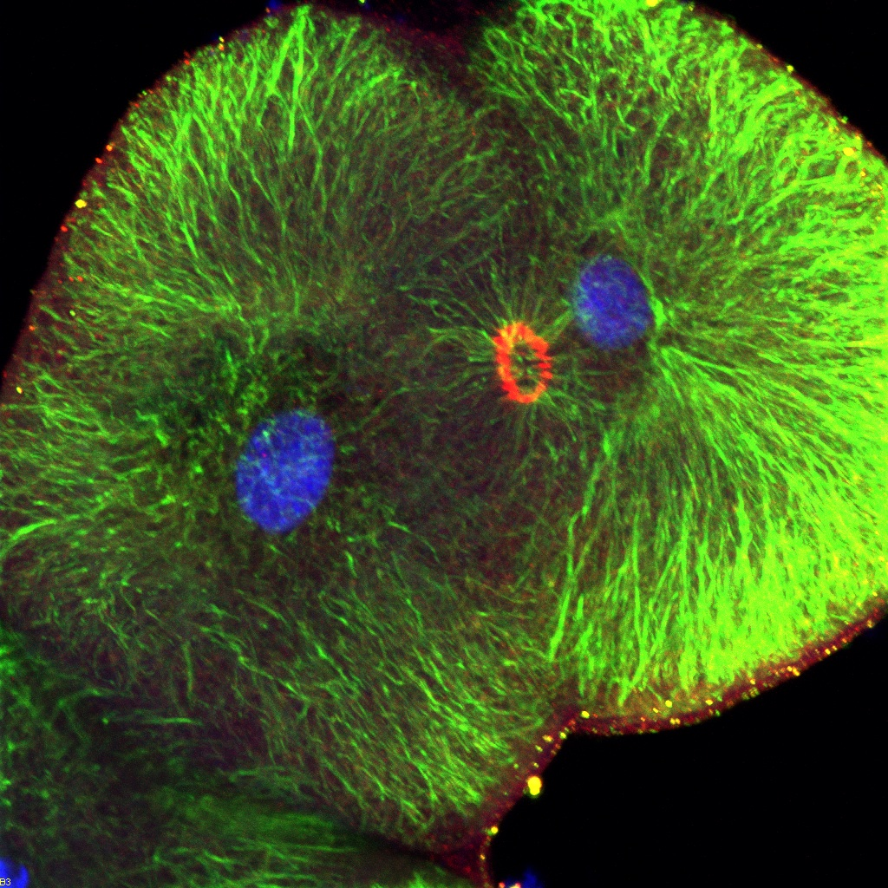
Laser scanning confocal microscopy – sea urchin embryo dividing (Mitosis)

Slide 8
Atomic Force Microscopy (AFM)
This technique ‘feels’ the surface of the specimen using a ‘probe’ and a computer is able to generate a 3D image.
The tip of the probe is brought very close to the surface of the specimen. The probe is on a cantilever and will move as the tip interacts with the specimen surface
A laser beam is bounced off the cantilever and a detector translates the degree of deflections into a 3D image.

Slide 9
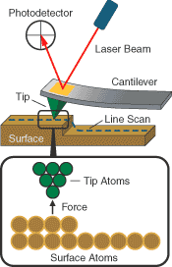
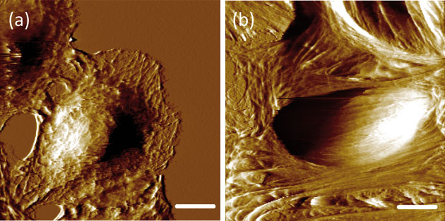
A normal cell surface and a cancerous cell surface

