Slide 2
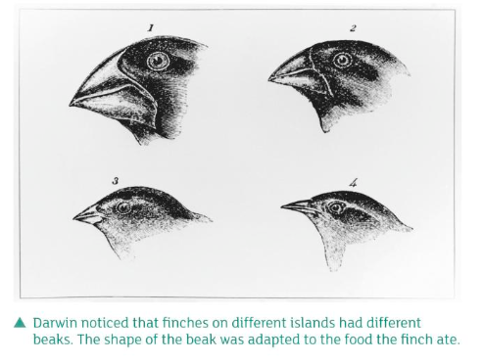

Slide 5
Answers

